Slide 1
A
Project Report
On
“A DEEP LEARNING BASED HUMAN ACTIVITY RECOGNITION USING WI-FI SIGNALS”
Presented By:-
Ashish Kumar Pokharel (NCE077BCT006)
Prashant Subedi (NCE077BCT021)
Sabina Pandey (NCE077BCT028)
Saksham Maharjan (NCE077BCT029)

Slide 2
Overview
Introduction
Literature Review
Problem Statement
Objectives
Scope
Proposed Methodology
Task Accomplished
Task Remaining
Expected Output
References

Slide 3
Introduction
Traditional HAR were vision based or sensor based.
Traditional method may lack privacy concern, be affected by lighting condition and limited visual range.
HAR through Wi-fi signals has gained significant attention through availability, versatility and high-performance capabilities.
Advanced HAR fused with deep learning assures a solution for these problems.

Slide 4
Literature Review
Collected data for seven human activities.
Used TP-Link Archer C20 and applied Nexmon tool on Raspberry Pi and , for human activity recognition in a single room.
Created the famous CSI-HAR dataset.
No preprocessing was implemented.
Used 2D-CNN and LSTM to recognize the activities.

Slide 5
Literature Review
Used CNN-GRU-AttNet model.
Used CSI-HAR dataset collected by [1].
Applied pre-processing consisting of denoising (PCA) and segmentation.

Slide 6
Literature Review
Proposed a new methodology for Wi-Fi based human activity recognition through wall.
Used Nexmon tool with Raspberry Pi and ALFA 1900 Wi-Fi card with antennas for better coverage.
Used LSTM model.

Slide 7
Problem Statement
Traditional methods require closed proximity to routers and are affected by reflections in confined spaces.
Sensing human activities through walls is unexplored.
Recognizing activities involving individuals through walls is inaccurate due to signal overlap and attenuation.

Slide 8
Objective
Objectives of this project are as follows:
To explore human motion sensing through wall.
To implement deep learning network to recognize the activities.
To utilize Raspberry Pi and Nexmon Firmware to monitor CSI data.
To design a system capable of collecting data through walls using wider-angle wi-fi sensing.

Slide 9
Scope
The system facilitates elderly care and patient monitoring.
Helps to identify fall or prolonged inactivity to alert care-givers.
Enhances patient safety by providing real-time alerts without the need for frequent physical checks.
Detects room occupancy and adjusts environmental controls such as lighting, heating, and cooling accordingly.

Slide 10
Methodology
Data Collection
Empty
Fall
Run
Stand
Walk

Slide 11
Methodology
Hardware Requirements
Raspberry Pi 4B model
Router
Software Requirements
Nexmon firmware patch
Tensorflow or Pytorch
Python Libraries (NumPy, Pandas, Matplotlib)
Visual Studio Code, Jupyter Notebook

Slide 12
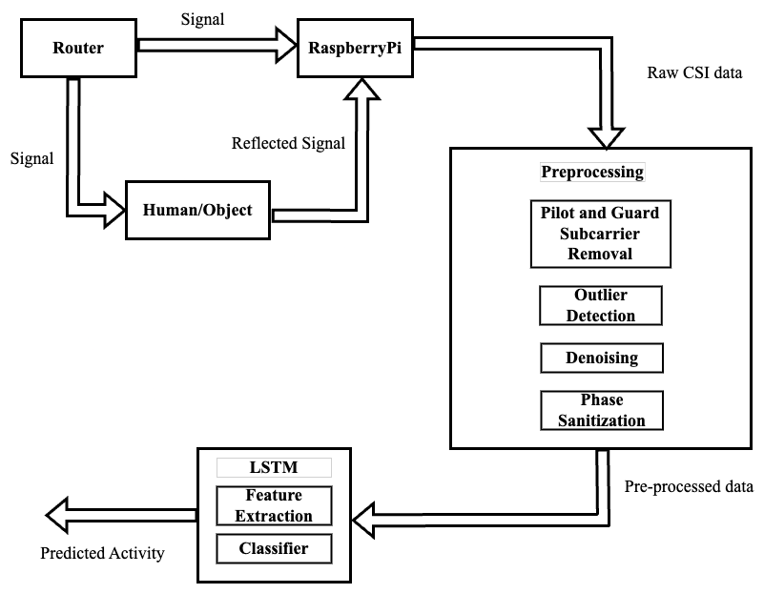
Methodology

Slide 13
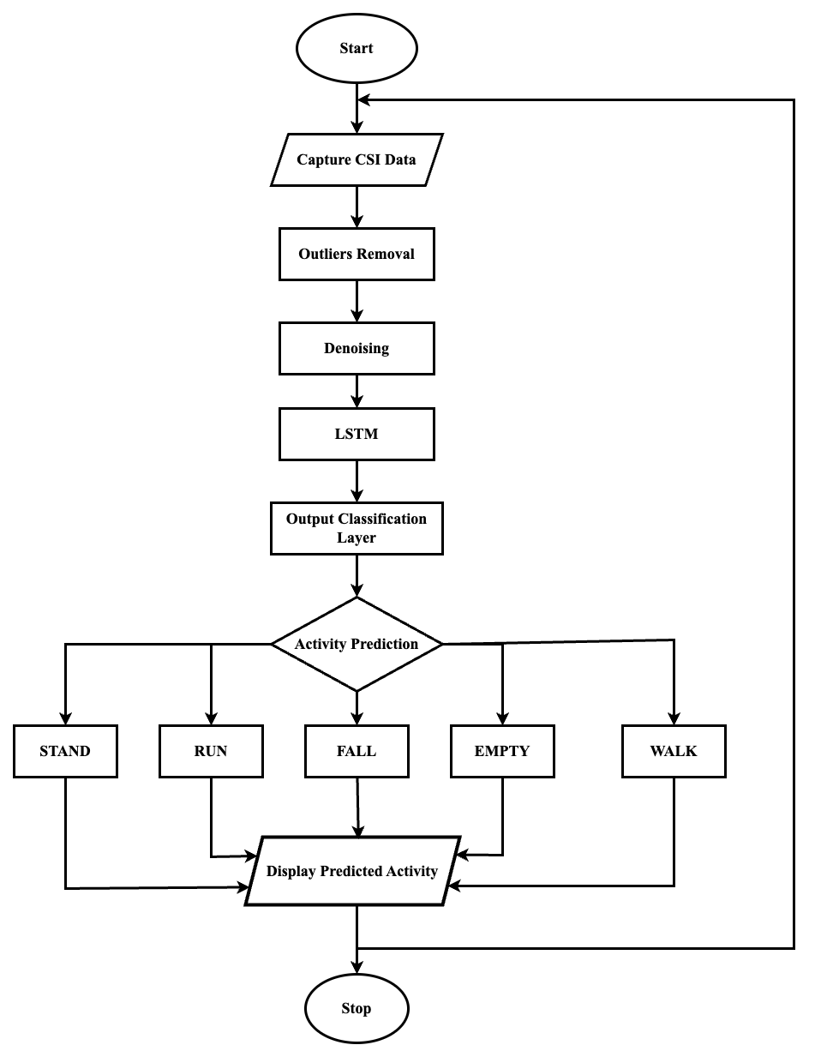
Methodology

Slide 14
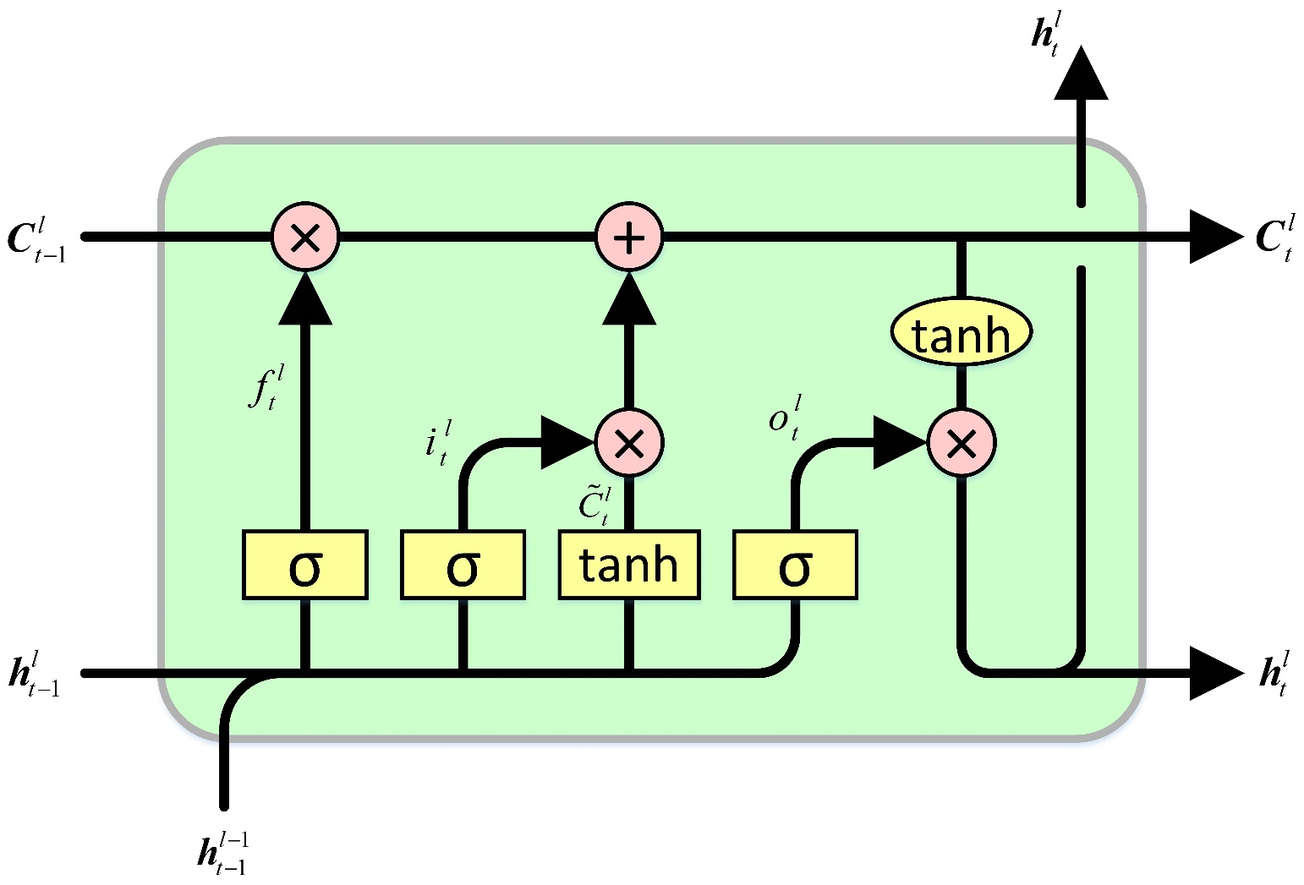
Methodology
LSTM ALGORITHM

Slide 15
Methodology
LSTM cell consists of:
Input gate to decide if the current cell input information is in needed to be stored in cell state.
Forget gate to decide if the previous cell state information should be forgotten or not.
Output gate to decide what information is to be produced as output.

Slide 16
Methodology
Performance Metrics:
Precision
Recall
F-score

Slide 17
Tasks Accomplished
Hardware Setup
Raspberry Pi4B as receiver.
Mikrotik SXT2 as transmitter.
Configuration
Nexmon Firmware patch to enable monitor mode in receiver.
Visualization
TCP/IP server client system to visualize and store the CSI data in real time.

Slide 18
Tasks Accomplished
Data Collection
Phase 1:
Collected data in LoS setup for five individuals.
Each activity done for 6 minutes.
Fall, Run, Stand, Walk.
PCAP format.

Slide 19
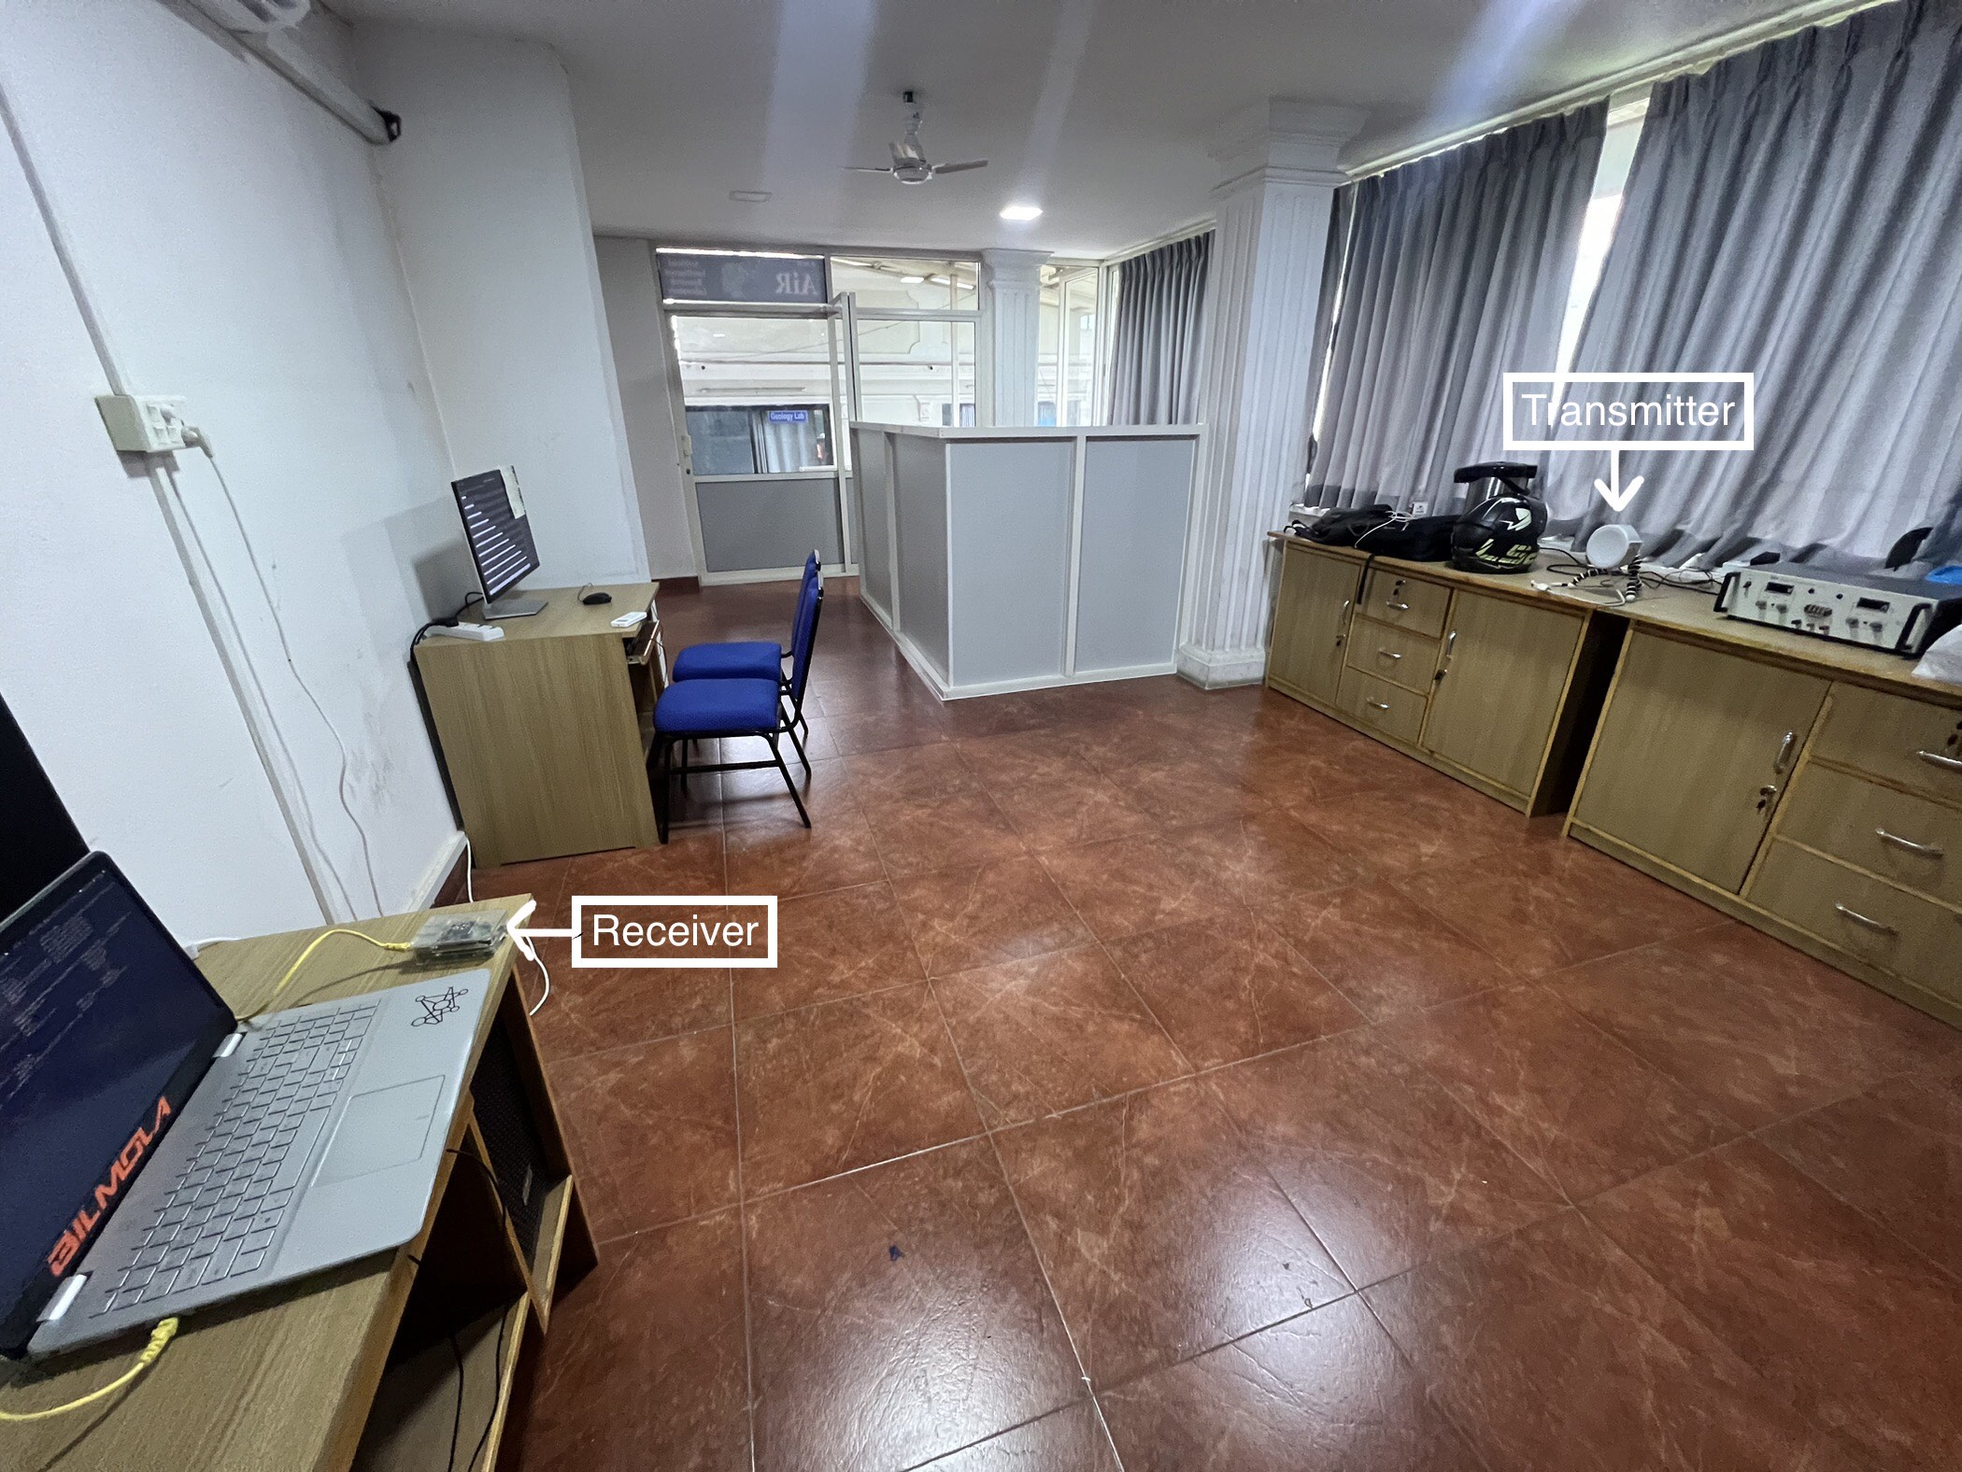
Tasks Accomplished

Slide 20
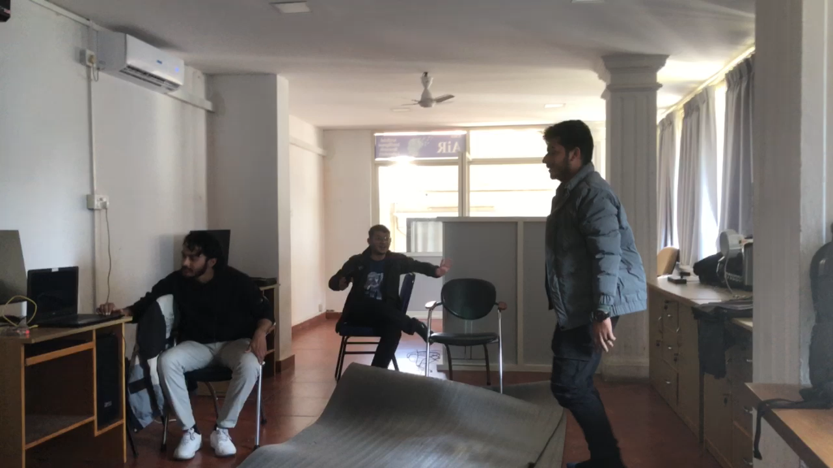
Tasks Accomplished

Slide 21
Tasks Accomplished
Data Collection
Phase 2:
Collected data in nLoS setup for 3 individuals.
Each activity done for 6 minutes.
Empty, Fall, Run, Stand, Walk.
PCAP format.

Slide 22
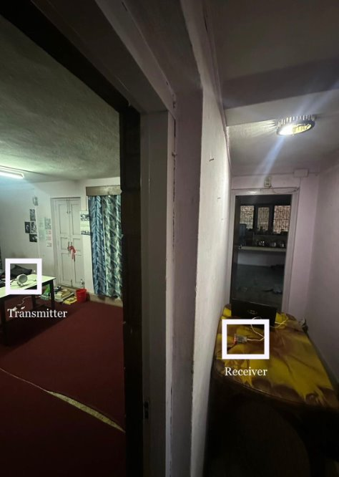
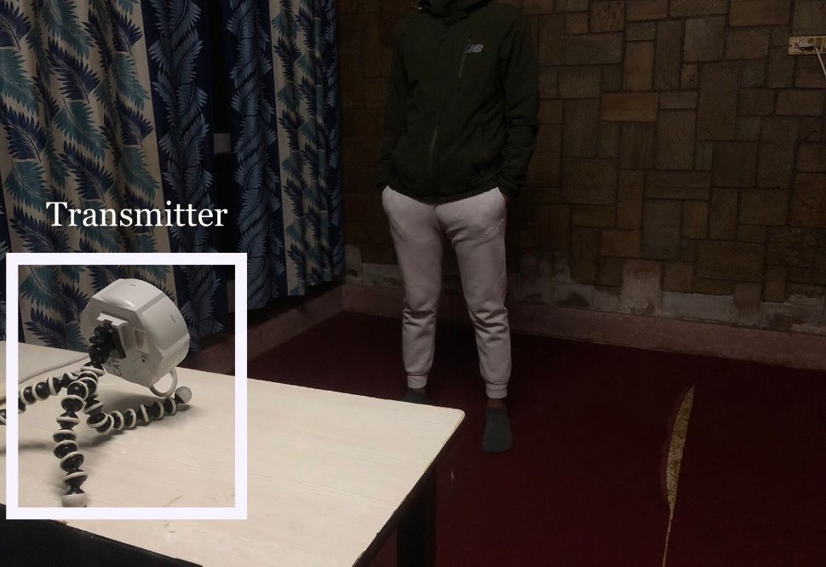
Tasks Accomplished

Slide 23
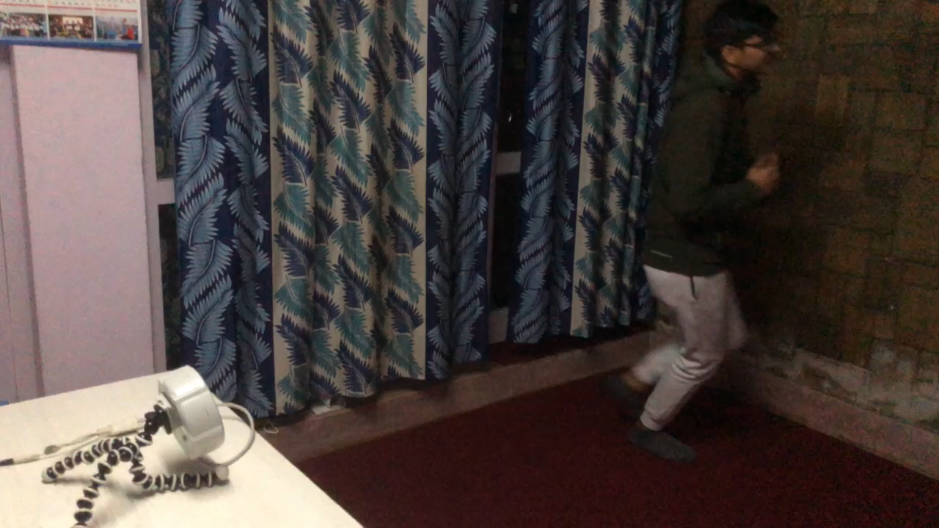
Tasks Accomplished

Slide 24
Tasks Accomplished
Preprocessing
Done for phase 1 & 2 data.
Subcarrier removal: Removal of guard, pilot and direct current (null) sub carriers.
Hample filter for amplitude outliers removal.
DWT( Discrete Wavelet Transform) for amplitude denoising.
Phase Sanitization for phase denoising.

Slide 25
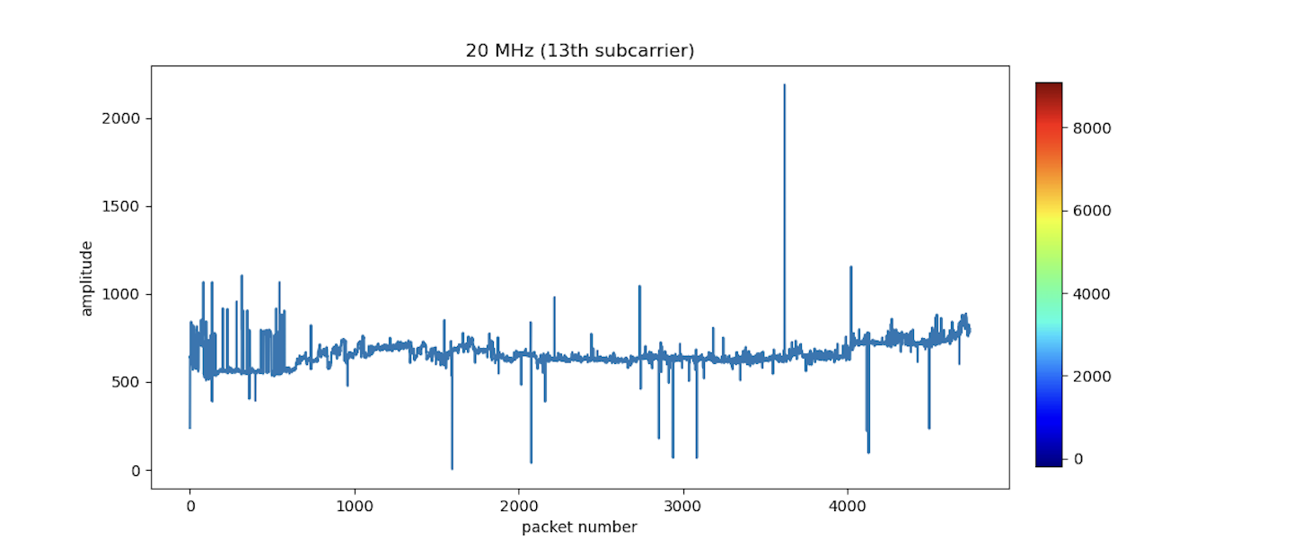
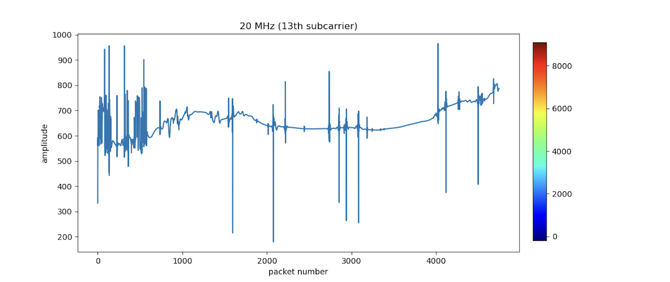
Task Accomplished

Slide 26
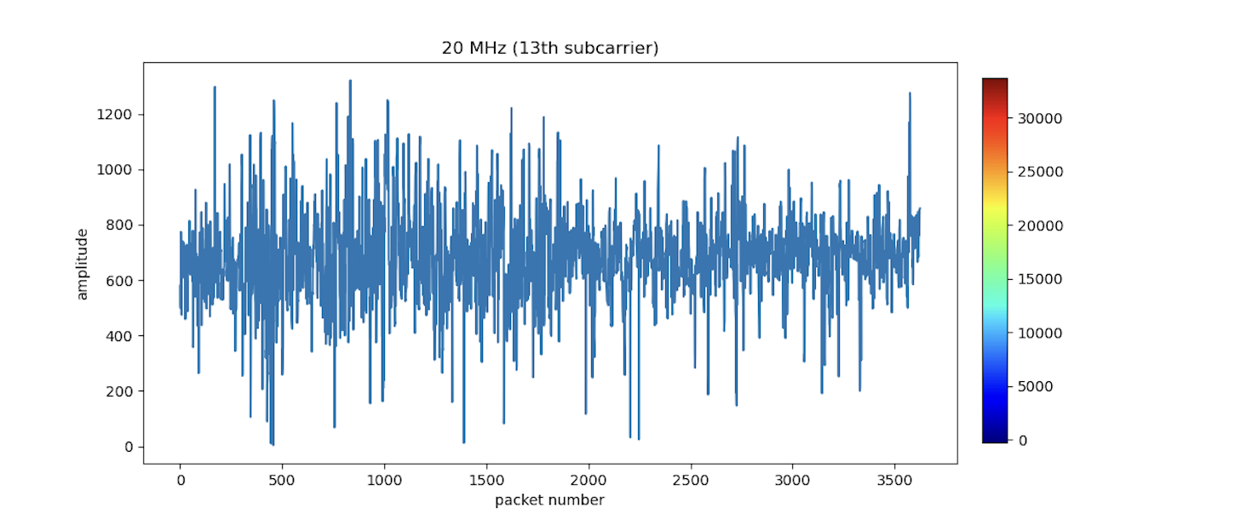
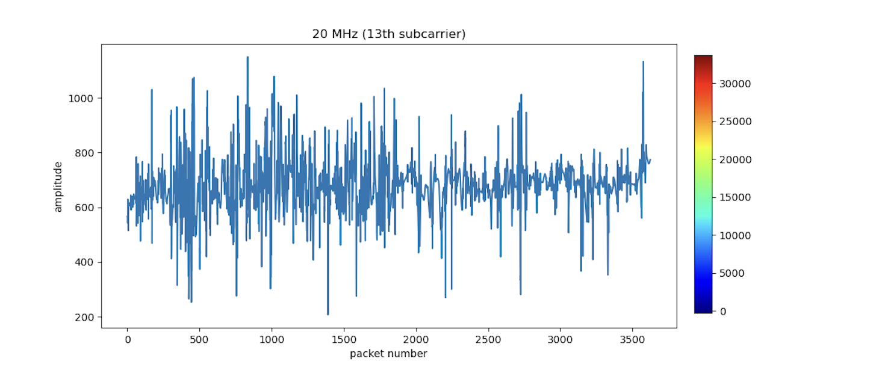
Task Accomplished

Slide 27
Tasks Remaining
Development of deep learning model for activity recognition in nLoS scenario.
Development of GUI and integration of all parts.

Slide 28
Expected Output
A desktop application will be developed that can identify human activities using Wi-Fi signals.

Slide 29
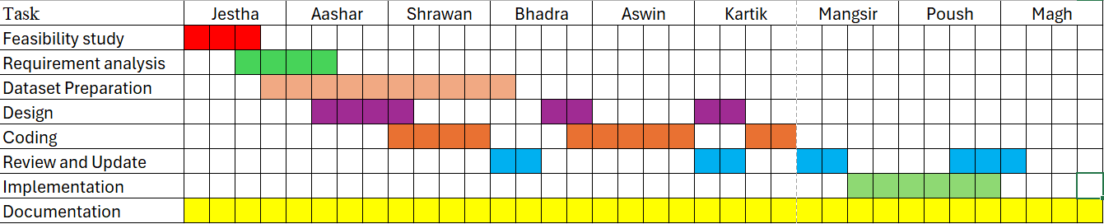
Project Timeline

Slide 30
References
[1] P. F. Moshiri, R. Shahbazian, M. Nabati, and S. A. Ghorashi, “A csi-based human activity recognition using deep learning,” Sensors (Basel, Switzerland), vol. 21, 10 2021.
[2] S. Mekruksavanich, W. Phaphan, N. Hnoohom, and A. Jitpattanakul, “Attentionbased hybrid deep learning network for human activity recognition using wifi channel state information,” Applied Sciences (Switzerland), vol. 13, 8 2023.
[3] F. S. Abuhoureyah, Y. C. Wong, and A. S. B. M. Isira, “Wifi-based human activity recognition through wall using deep learning,” Engineering Applications of Artificial Intelligence, vol. 127, 1 2024.

Slide 31
Thank You

